Slide 1



Conseil
CCH Tagetik -
Client Success Story: Caisse des dépôts et placement du Québec
How CCH Tagetik helped the Canadian public pension fund streamline its financial processes

Slide 2
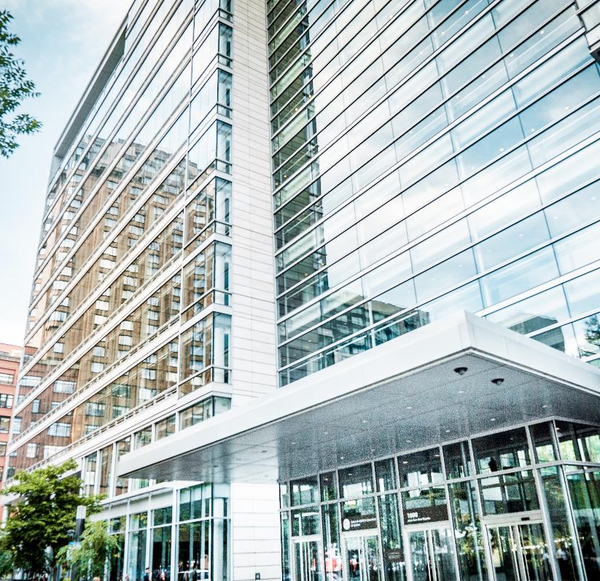
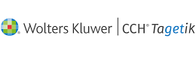
Client Success Story: Caisse des dépôts et placement du Québec
How CCH Tagetik helped the Canadian public pension fund streamline its financial processes
Context
The Caisse des dépôts et placement du Québec (CDPQ) is a long-term institutional investor that manages funds primarily for public and parapublic pension and insurance plans in Quebec, Canada. As of December 31, 2023, it held CA$434 billion in net assets. CDPQ invests globally in major financial markets, private equity, infrastructure, real estate and private debt.
Challenges
CDPQ faced several challenges in managing its financial processes, such as financial consolidation, accounting and analytical allocation, budgeting, strategic planning as well as expenses transfers between cost centers.
These processes were complex, time-consuming, error-prone and dependent on multiple excel files and systems. CDPQ needed a solution that could:
  automate and integrate these processes,
  provide reliable and consistent data,
  increase collaboration between departments
  enable faster and deeper analysis for decision making.

Slide 3
Client Success Story: Caisse des dépôts et placement du Québec
How CCH Tagetik helped the Canadian public pension fund streamline its financial processes
Solution
CDPQ chose CCH Tagetik, a corporate performance management (CPM) software that provides a unified platform for financial consolidation, planning, reporting, analytics and regulatory disclosure. CCH Tagetik is designed to handle complex financial processes with ease, accuracy and flexibility. CCH Tagetik was implemented to support the following processes at CDPQ:
Financial consolidation: CCH Tagetik enabled CDPQ to automate the complex consolidation of its financial statements, eliminating manual adjustments and reconciliations, and ensuring compliance with accounting standards and regulatory requirements.
Allocations: the solution allowed CDPQ to allocate their offices indirect expenses across its business units and investment portfolios, based on predefined rules and drivers, and to perform various what-if scenarios and simulations.
Budgeting and strategic planning : CCH Tagetik facilitated CDPQ to plan its offices expenses, using top-down and bottom-up approaches, and to transfer costs between cost centers.
Implementation
CDPQ was supported by Raymond Chabot Grant Thornton (RCGT), a leading Canadian accounting and consulting firm and a CCH Tagetik partner, in the implementation of the accounting and analytical allocation processes, as well as the budgeting and strategic planning. RCGT provided CDPQ with expertise, guidance and best practices to ensure a successful and timely deployment of CCH Tagetik.
Results
By implementing CCH Tagetik, CDPQ achieved the following benefits:
Improved efficiency and accuracy: CCH Tagetik reduced the time and effort required to complete the financial processes, minimized the risk of errors and inconsistencies, and enhanced the data quality and integrity.
Increased agility and visibility: the solution enabled CDPQ to adapt quickly to changing business and market conditions, to perform multidimensional analysis and drill-downs, and to access real-time information and insights.
Reduced dependency and complexity: CCH Tagetik eliminated the need for multiple excel files and manual interventions, and provided a single source of truth for the financial processes.
Enhanced decision-making and performance: the solution empowered CDPQ to align its financial and strategic objectives, to optimize its resource allocation and investment strategies, and to measure and monitor its financial results and indicators.

